Slide 1
Workstation Installation

Slide 2
Install the ChefDK
Now it's time to install the tools on your system
Install the ChefDK
Open a PowerShell Prompt
Execute a series of commands to ensure everything is installed
Install git (optional)
Install a text editor (optional)

Slide 3
ChefDK
The omnibus installer is used to set up the Chef development kit on a workstation, including the chef-client itself, an embedded version of Ruby, RubyGems, OpenSSL, key-value stores, parsers, libraries, command line utilities, and community tools such as Kitchen, Berkshelf, and ChefSpec.
https://downloads.chef.io/chef-dk/

Slide 4
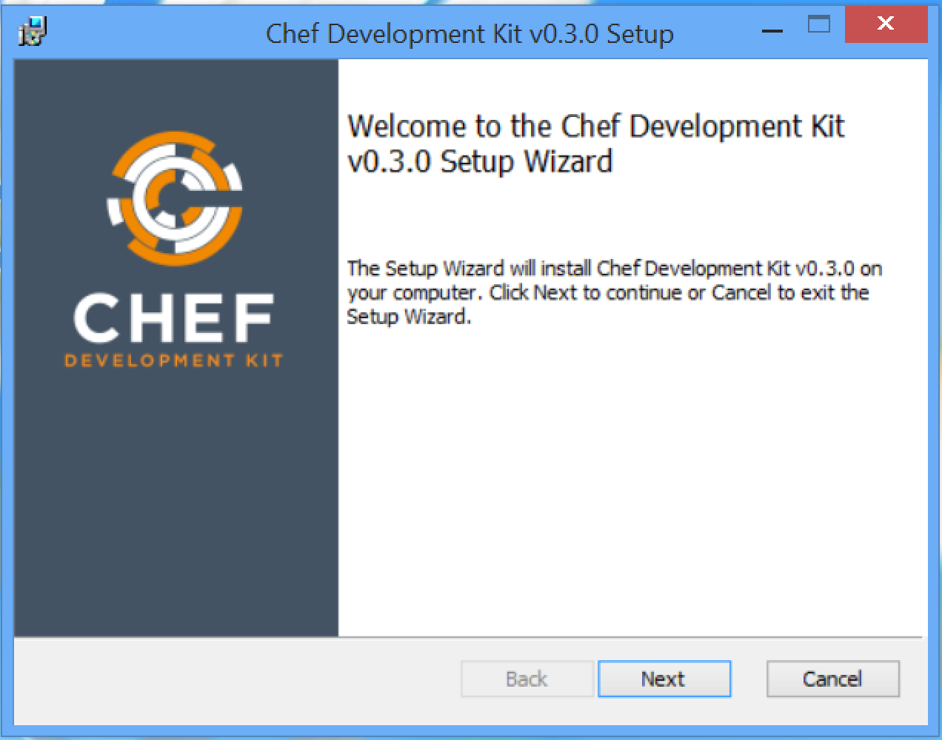

Slide 5
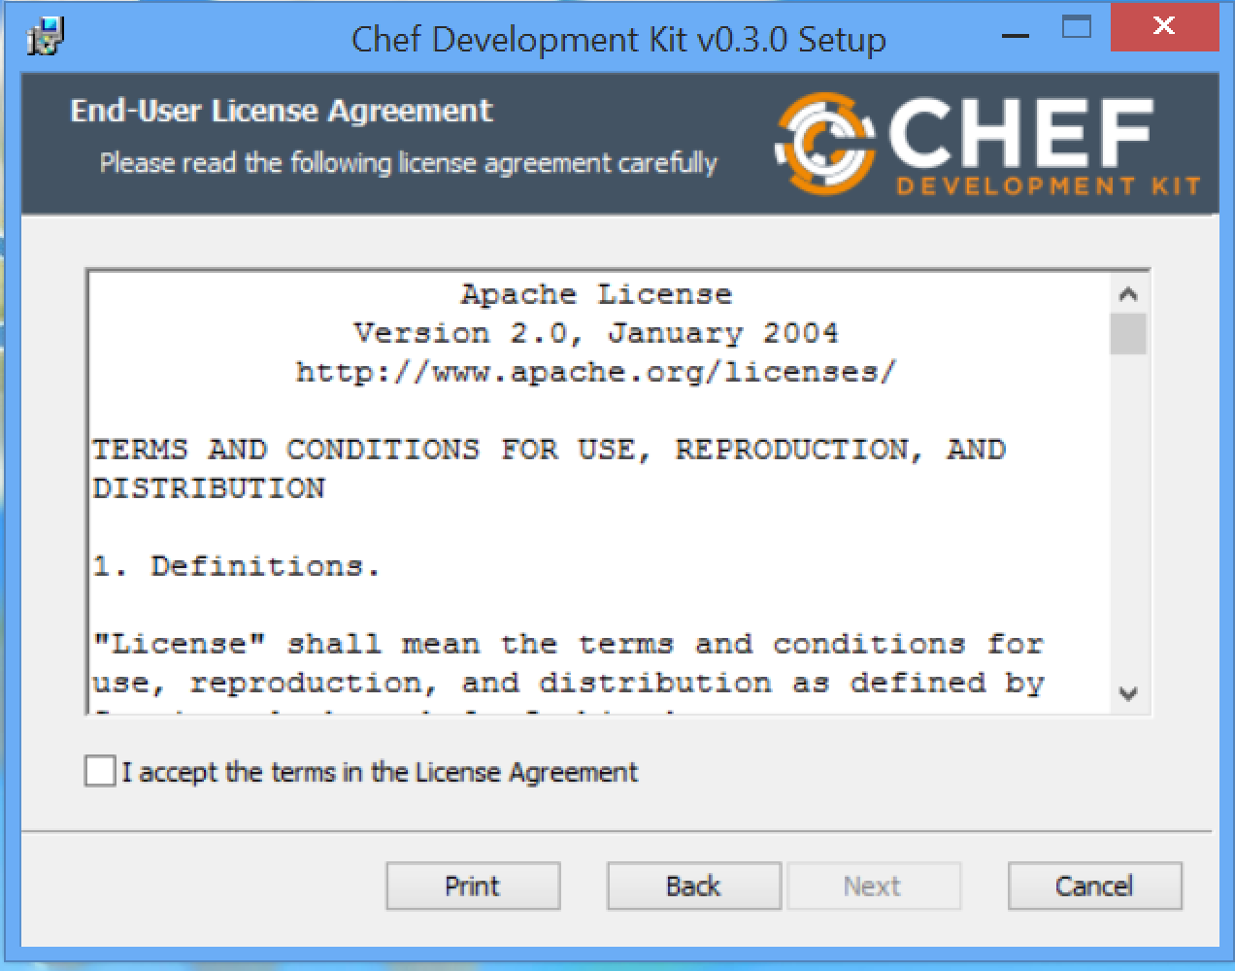

Slide 6
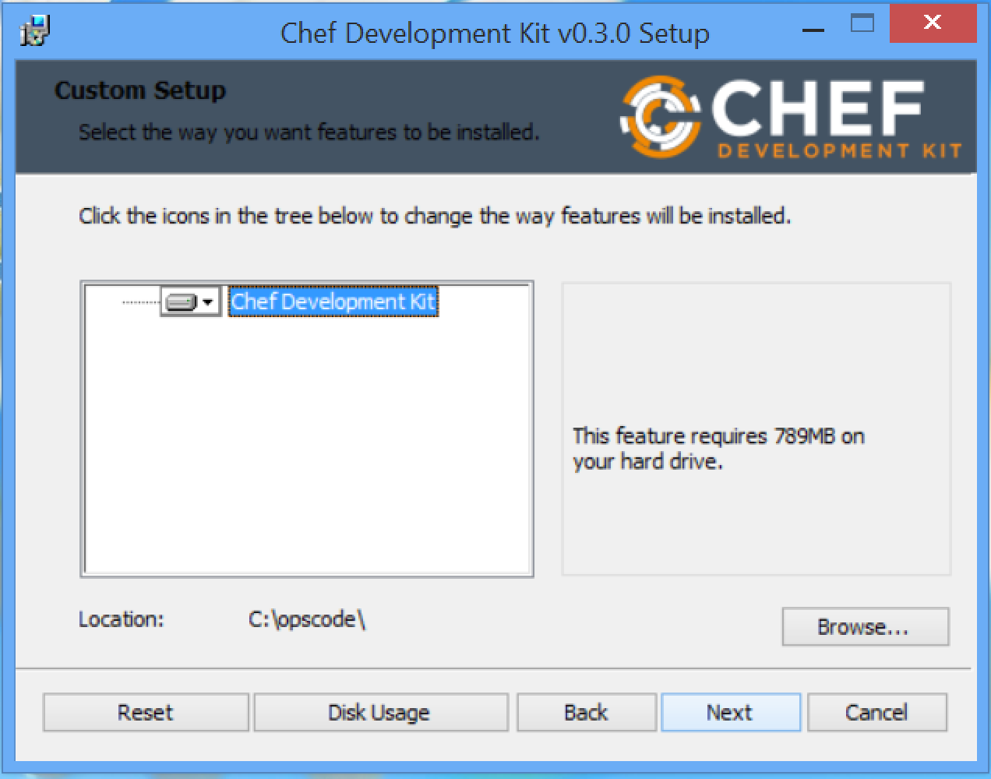

Slide 7
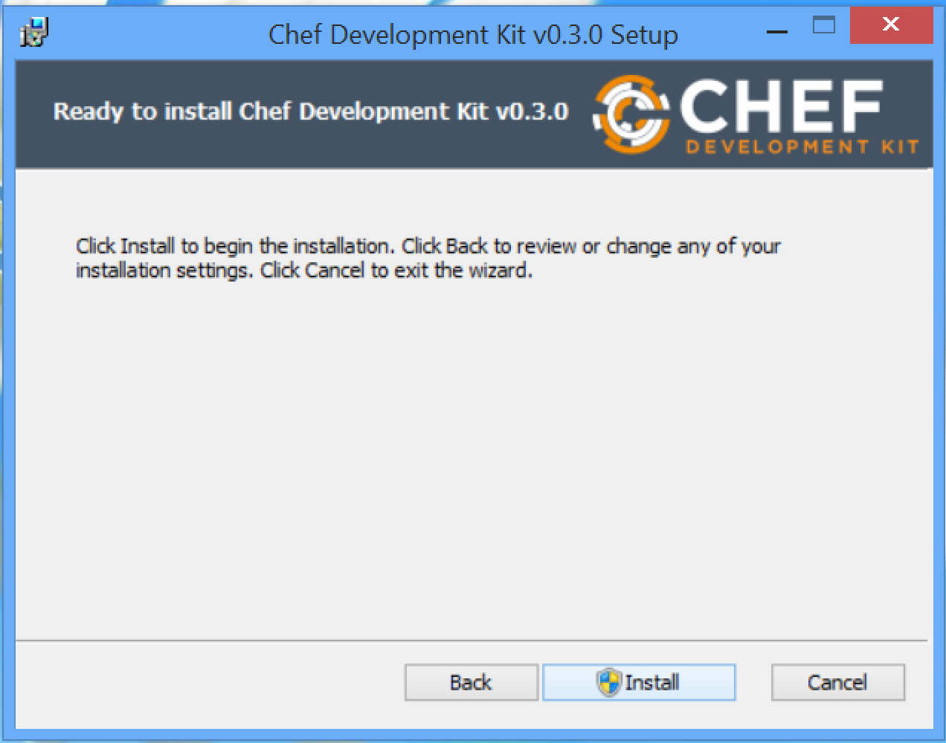

Slide 8
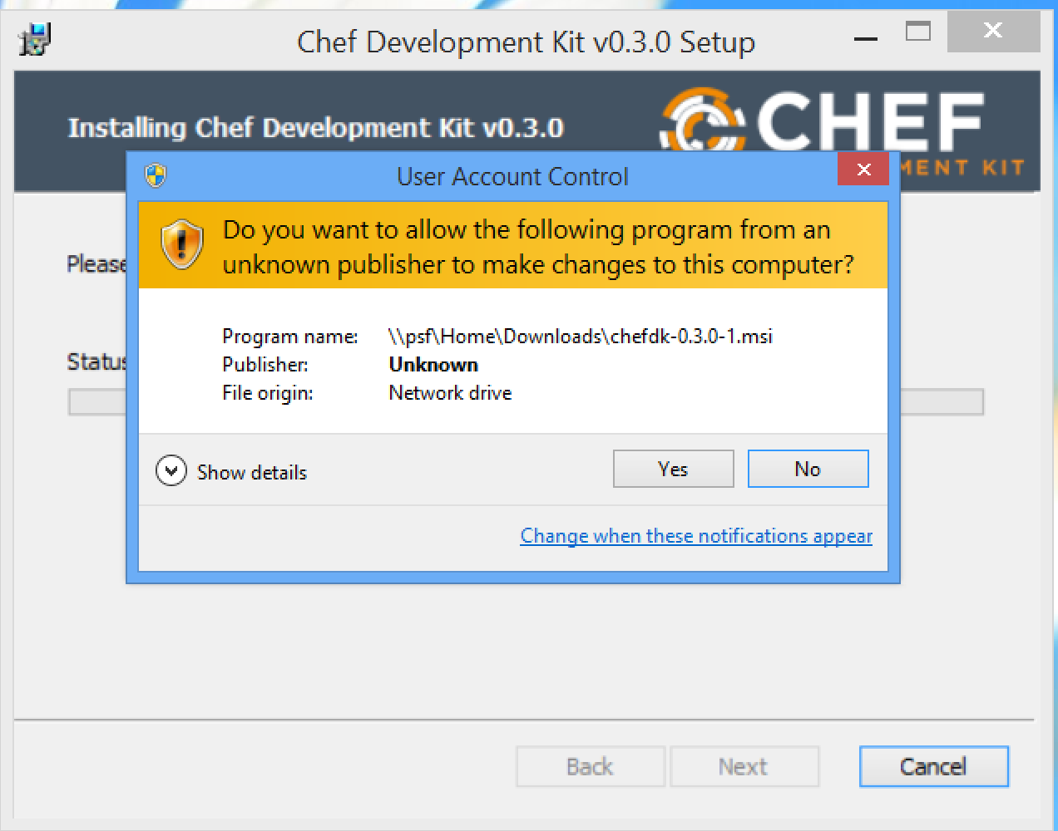

Slide 9
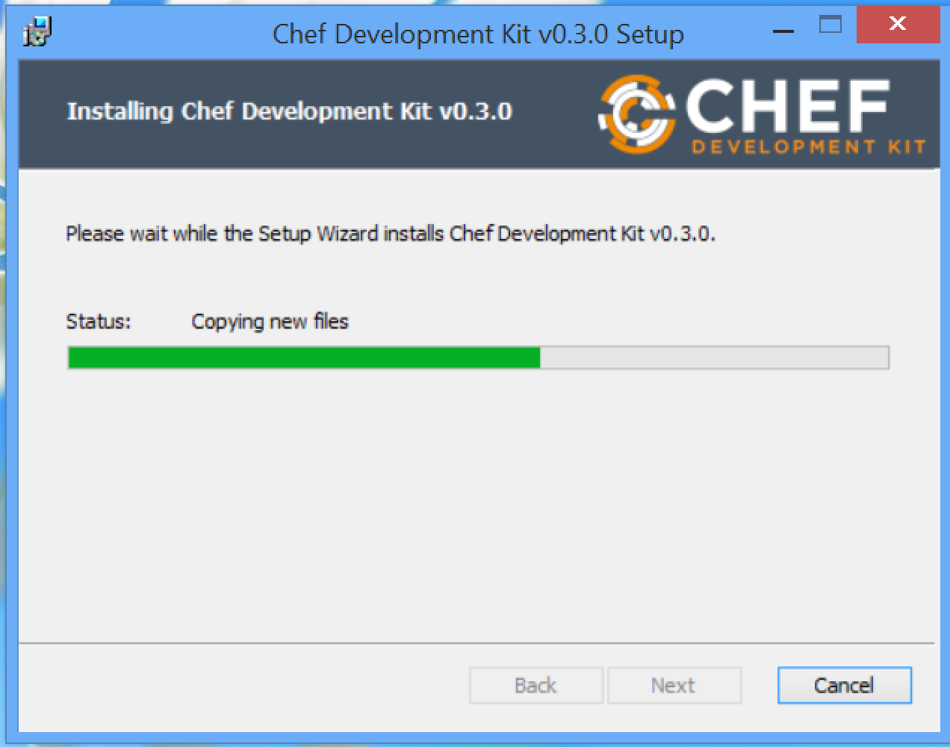

Slide 10
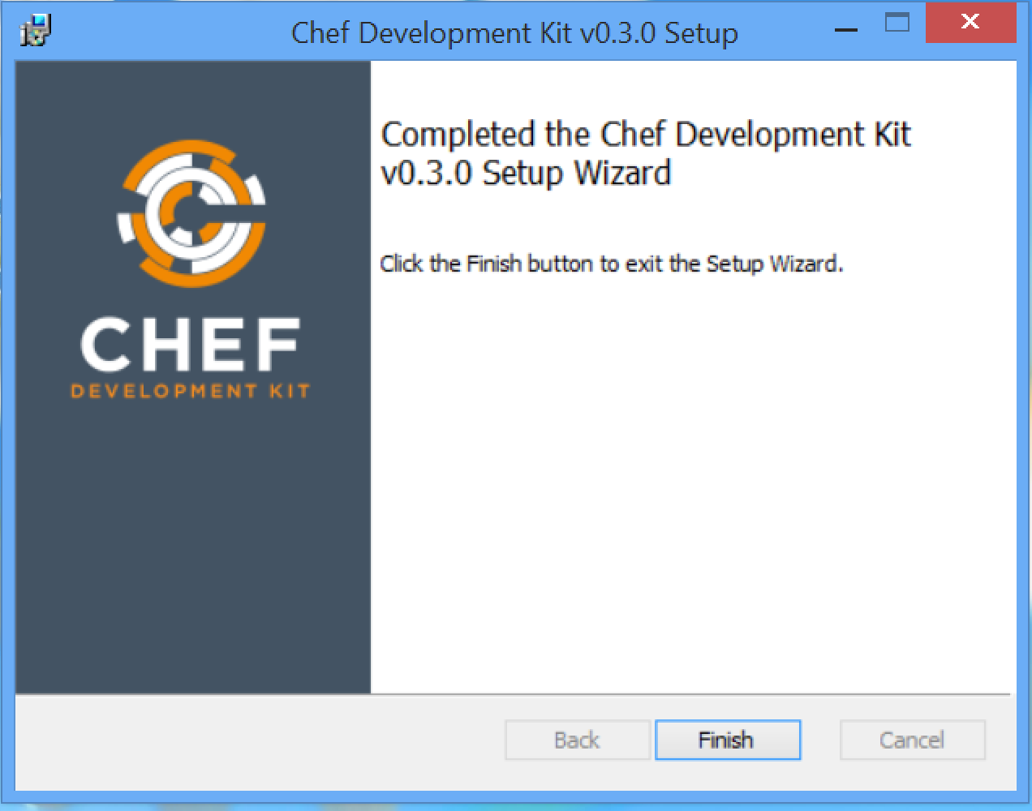

Slide 11
Run All These Commands
PS > chef --version
PS > chef-client --version
PS > knife --version
PS > ohai --version
PS > berks --version
PS > kitchen --version
PS > foodcritic --version
PS > rubocop --version

Slide 12
git
Git is a distributed revision control system with an emphasis on speed, data integrity, and support for distributed, non-linear workflows. Git was initially designed and developed by Linus Torvalds for Linux kernel development in 2005, and has since become the most widely adopted version control system for software development.
http://git-scm.com/downloads

Slide 13
Sublime Text
Sublime Text is a sophisticated text editor for code, markup and prose.
You'll love the slick user interface, extraordinary features and amazing performance.
http://www.sublimetext.com

Slide 14
ATOM Editor
At GitHub, we're building the text editor we've always wanted. A tool you can customize to do anything, but also use productively on the first day without ever touching a config file. Atom is modern, approachable, and hackable to the core. We can't wait to see what you build with it.
https://atom.io

